Slide 1
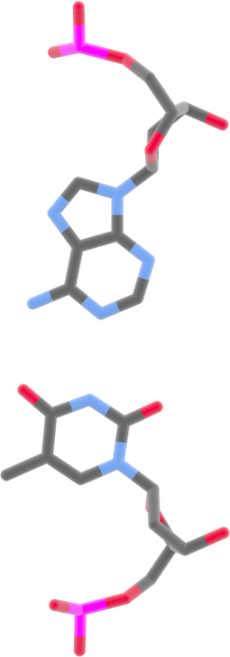
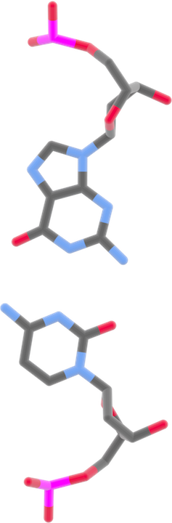
DNA base pairing
Adenine
Thymine
Cytosine
Guanine

